Slide 1

Being Agile in the Arctic – Adapting Systems to Changing Environments
CDR Mike Roberts, USPHS, PE, rehs
Deputy director of Project management
Alaska native tribal health consortium – division of environmental health and engineering

Slide 2
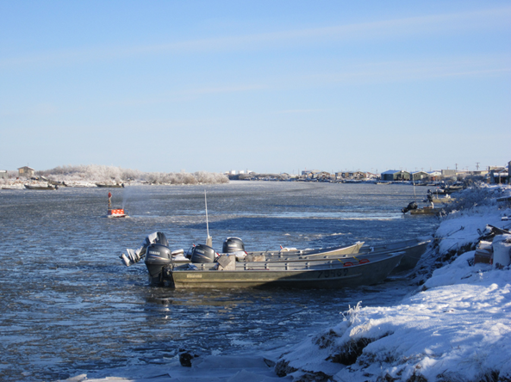
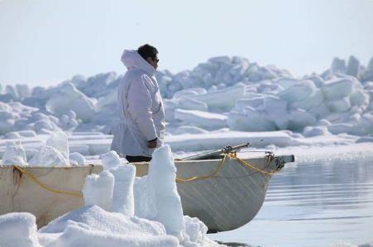
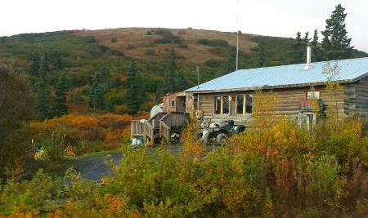
Overview
Who is ANTHC - DEHE?
Changing Environments
    Elements of Change
    Impact on Engineering Approaches
    ANTHC Innovation

Slide 3
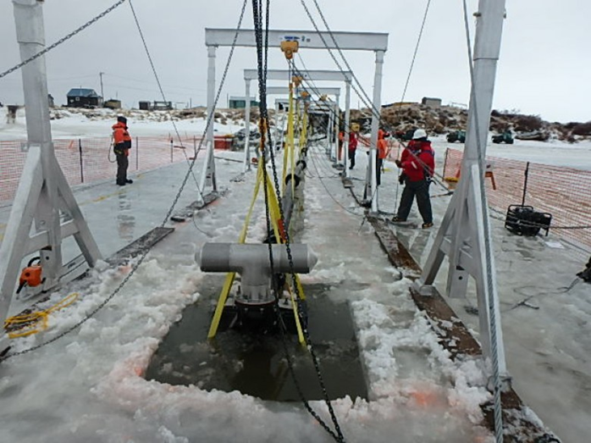
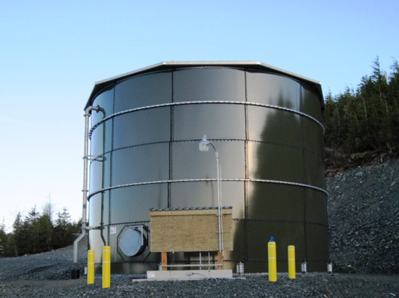
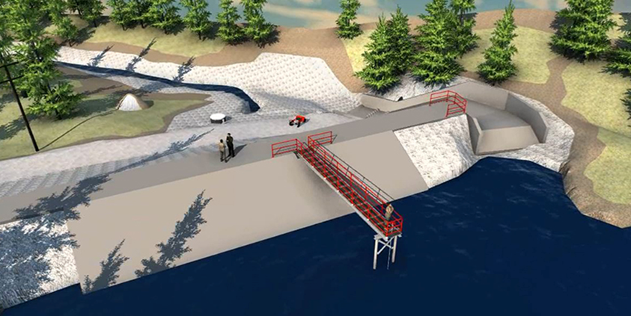
Who is ANTHC - DEHE?
Project Managers
Engineers
Construction Managers
Field Construction Team
  Types of Projects:
    Sanitation (Water, Sewer, Solid Waste)
    Energy Systems
    Transportation
    Clinics

Slide 4
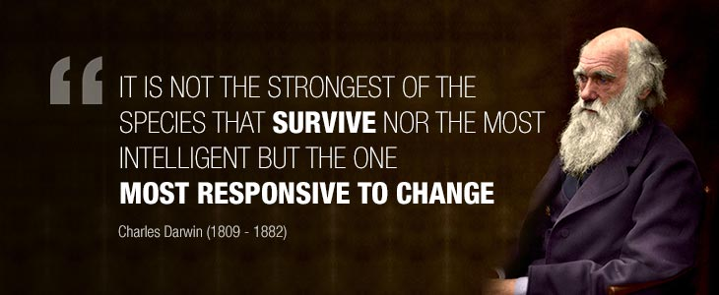
Agility
Refers to distinct qualities that allow organizations to respond rapidly to changes in the internal and external environment without losing momentum or vision.

Slide 5
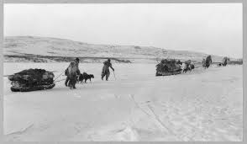
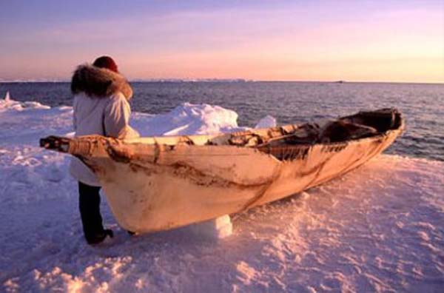
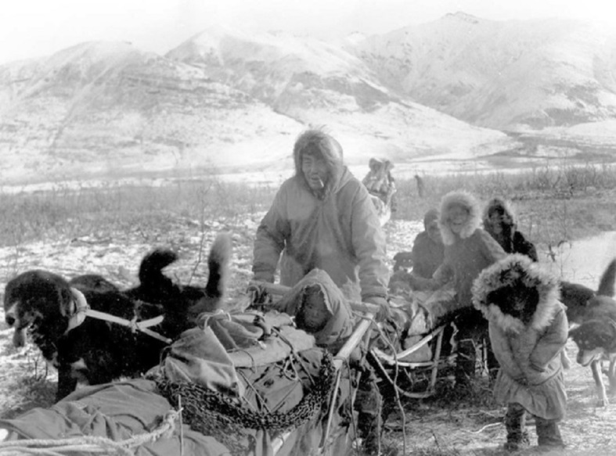
Historic “Arctic Agility”

Slide 6

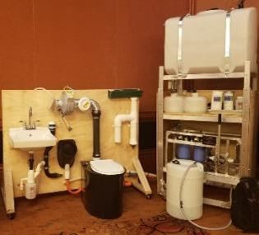
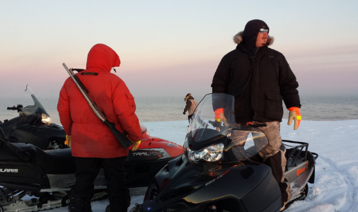
Modern Agility
Agility = Ability to Change
  Elements of Change
    Political – Financial Environment
    Natural Environment
New Ideas and Technologies Emerge
Villages LITERALLY must be Agile to survive!

Slide 7


Political –Financial Environments
Changes In the Political – Financial Realm
  Political “Will” of the People – Local Politics
    Tribes, Cities, Corporations
    Constant Turnover – New Leadership – Variable Desires
  Regulations
    Changes to Allowable Contaminant Concentrations
    Treatment Levels, Techniques, Sizing, Locations
  Funding Amounts and Availability
    Wide Fluctuation Year to Year
    New Programs, New Requirements, “Shifting Landscape”

Slide 8
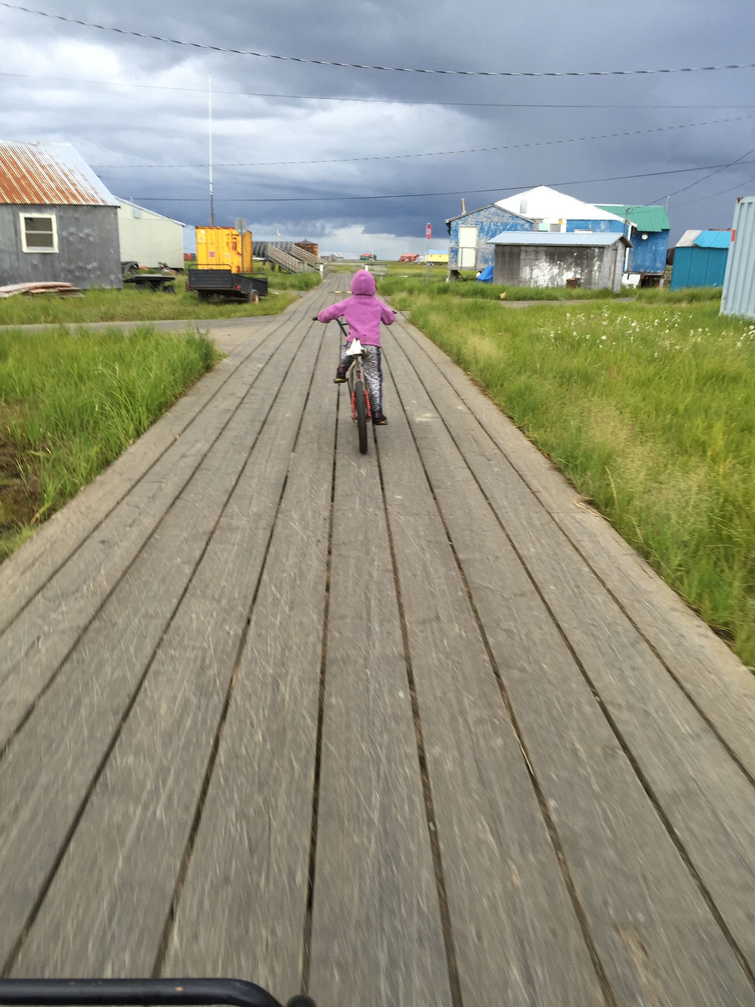
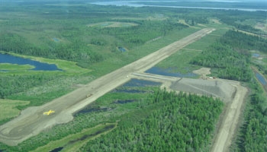
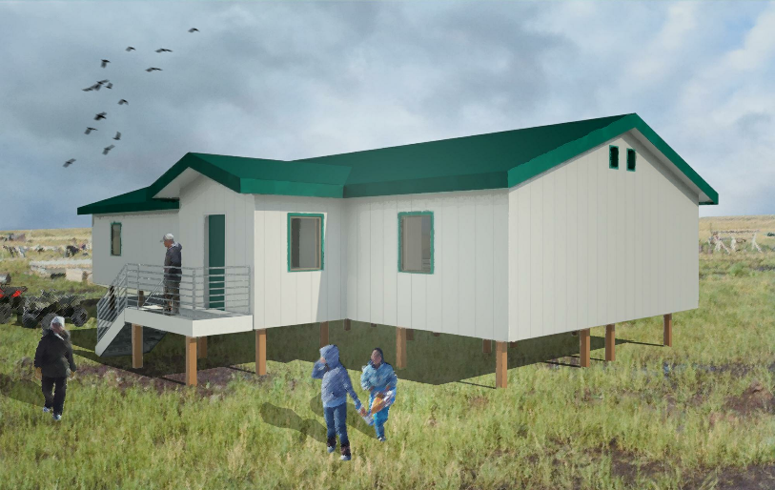
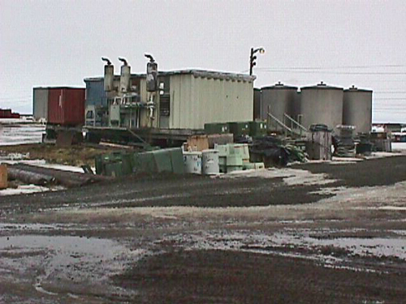
Agile Innovations
Addressing Changes in Political Will
  Wide Scale “Holistic” Planning
    Maximize Stakeholder Integration
      Sanitation, Energy, Transportation, Housing, Health Care, Fuel
    Address the Natural Environment – Adapt to Changes
    Address the Built Environment – Strategically Plan the Implementation
    Seek Buy-In/Support from All Stakeholders
    Key: Communication and Presence!

Slide 9
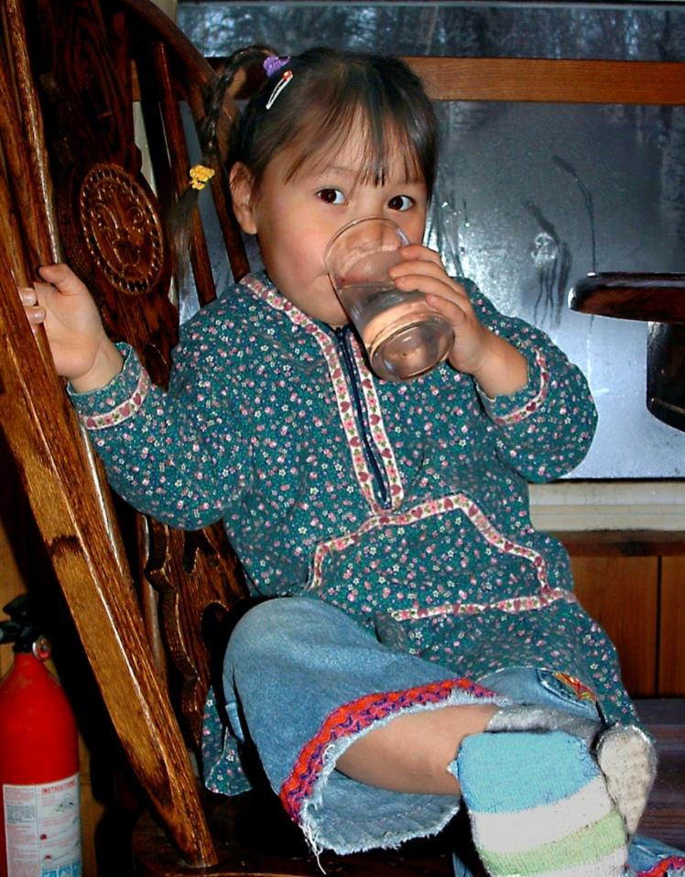
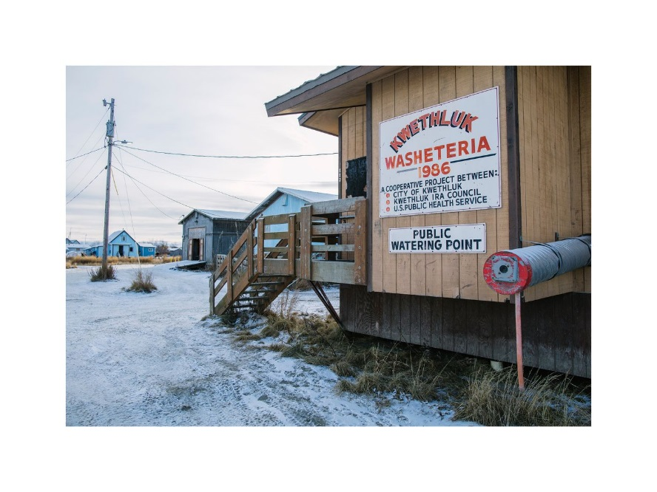
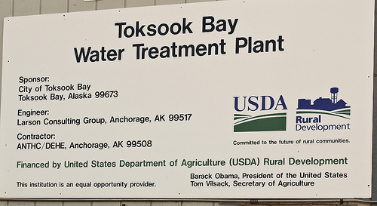
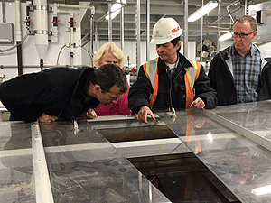
Agile Innovations
Addressing Changes in Regulations
  Trend – Increasing/More Restrictive Regulatory Environment
  Knowledge and Coordination are Key
  Work with Regulators – Regular Meetings and Involvement
  Make EPA and ADEC Part of the Solution!

Slide 10
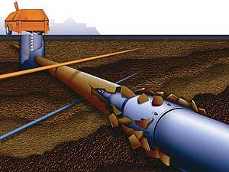
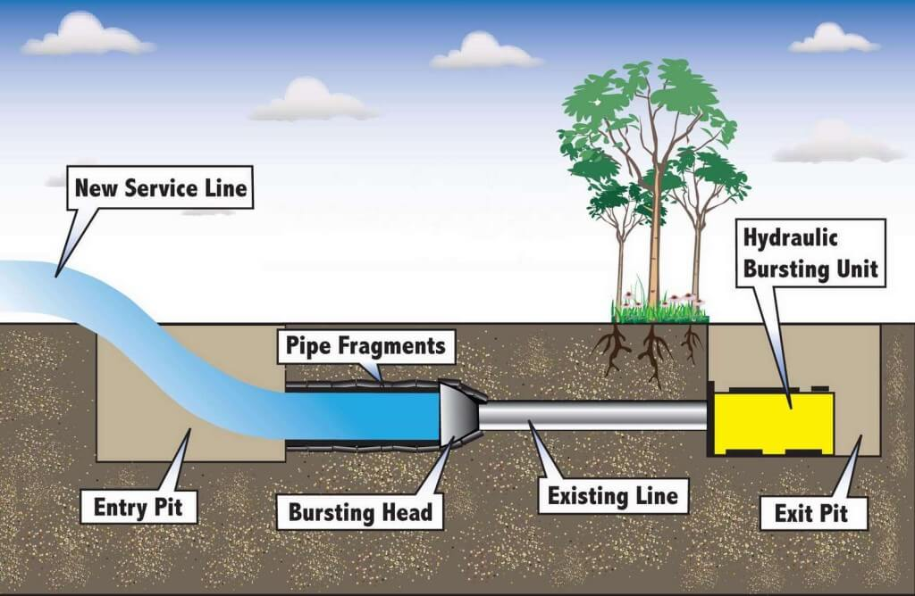
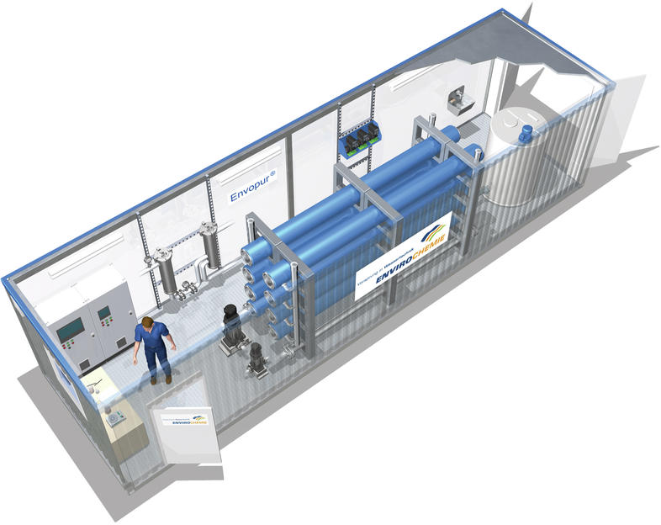
Agile Innovations
Addressing Changes in Funding
  Trend – Funding Up, More Scrutiny
  Trend – Construction Costs More Every Year!
  Value Engineering and Construction Efficiency are Critical
    Co-locate projects – share mobilization and overhead
    Simpler Systems
    Cost saving construction techniques
      Minimize Deep Excavations
      Pipe bursting and Directional Drilling
      Rehab Old Systems vs. Build New
      Modular Systems
  Construction Efficiency - Project Controls are Key!
    Earned Value Management

Slide 11
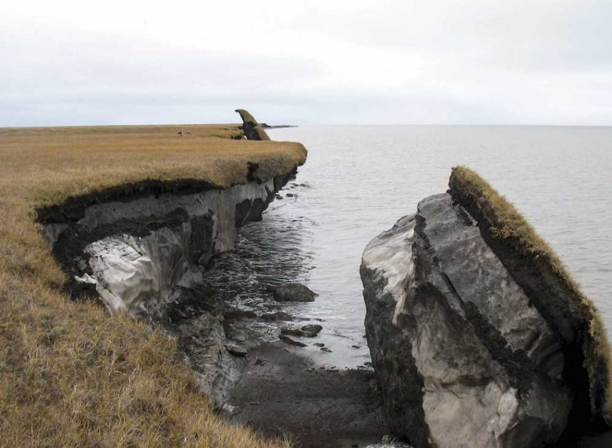
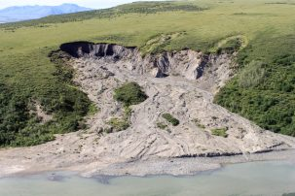
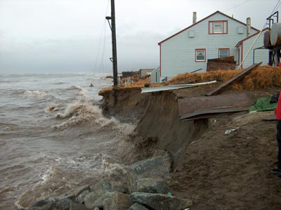
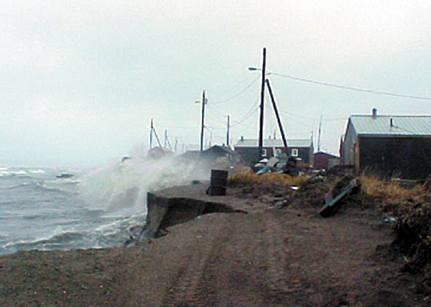
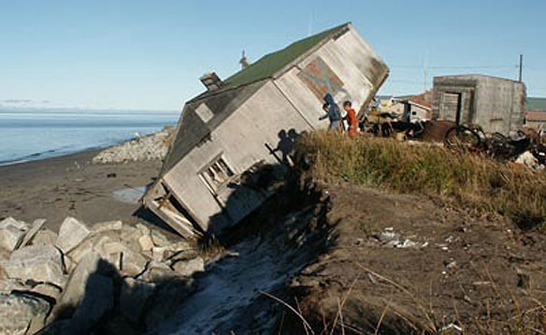
Environmental Change
Elements of Change
  Climate Change Impact on Infrastructure
    Permafrost Melting – Infrastructure Settling/Sinking
    Shoreline Erosion – Catastrophic Foundation Failure
    Natural Disasters – Flooding

Slide 13
Agile Innovations
“Defend in Place” – Sinking Infrastructure
  Active Thermosyphon Systems
    Passive Thermosyphons Stop Working
    Weld-On Extension
    Clamp – On Hybrid Heat Exchanger
    Install Chiller and Solar Power System
    Average System Cost- $300-$400K

Slide 14
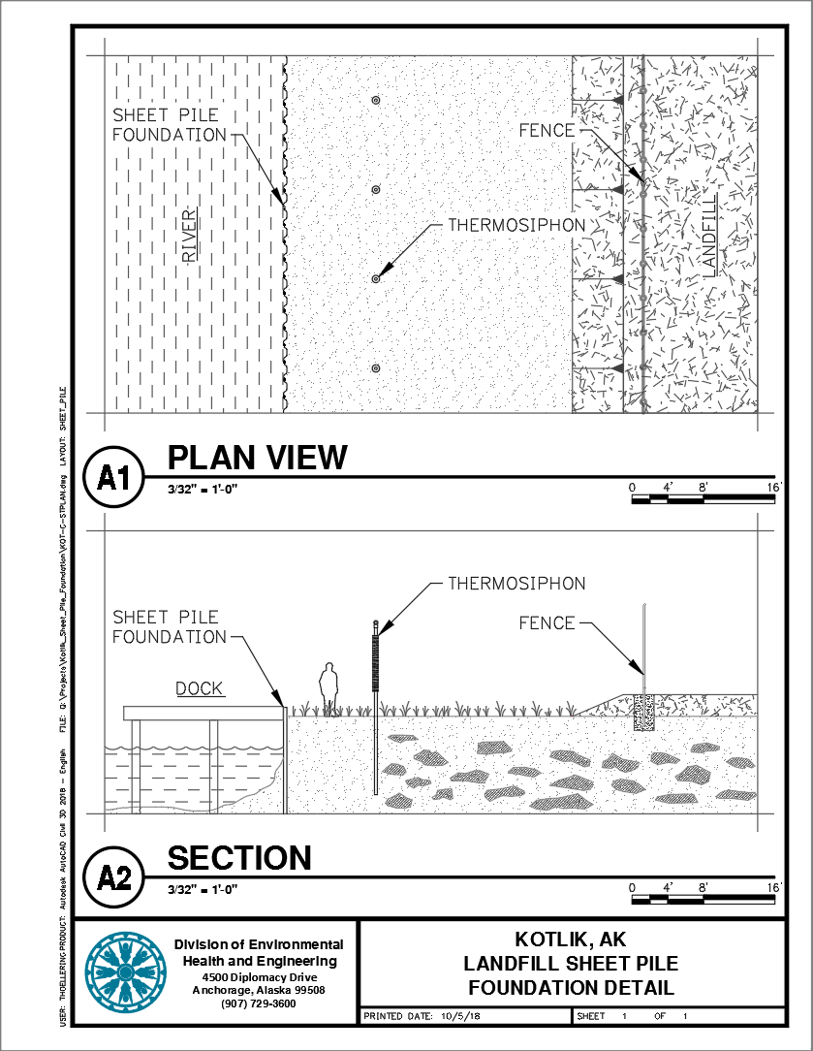
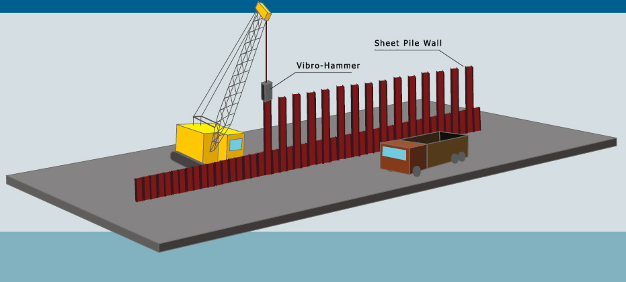
Agile Innovations
“Defend in Place” – Erosion Threatened Infrastructure
  Thermosyphon – Sheet Pile Shoreline System
    Standard Sheet Pile Bank Protection
    Shore-based Thermosyphon Stabilization System
    Conceptual System
    Much Less Expensive than Seawall

Slide 15
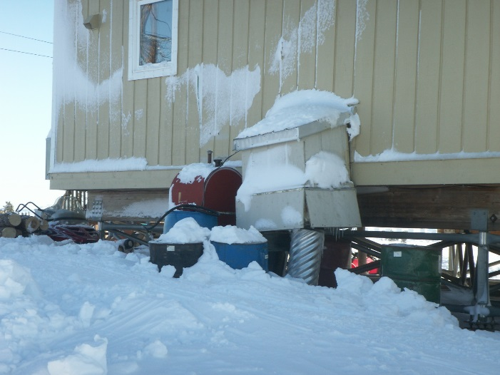
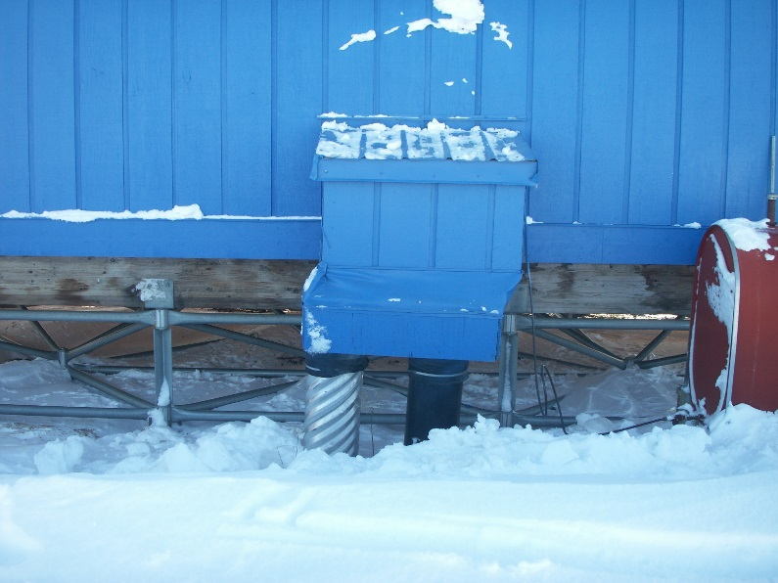
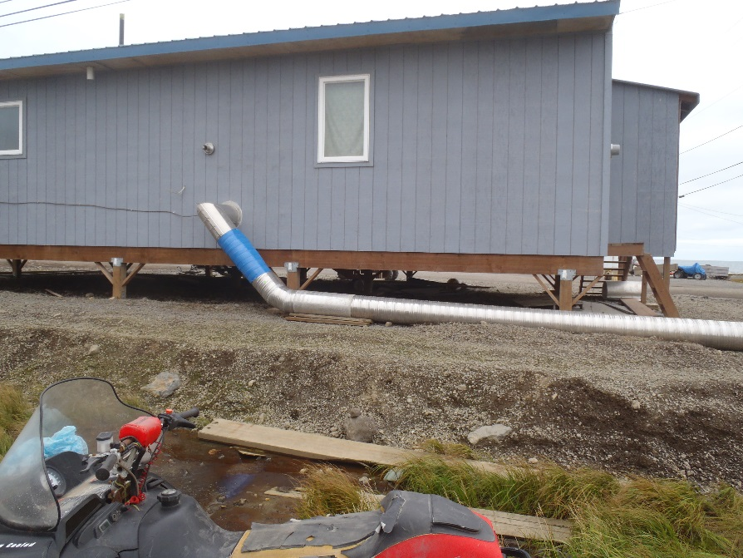
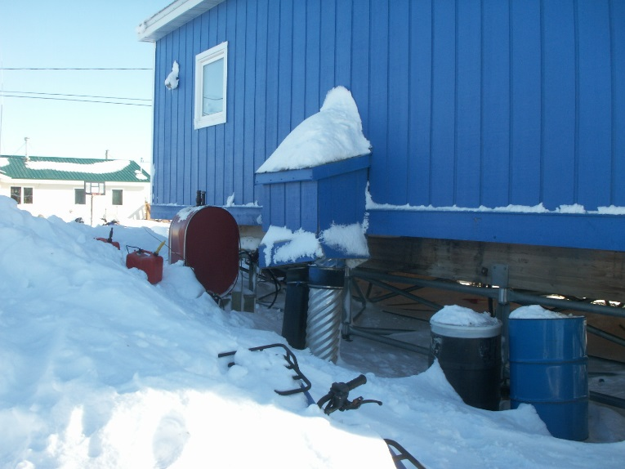
Agile Innovations
Flexible Water and Sewer Service Connections
  Allows for differential settling of the home
  Kotlik, Savoonga,
  New Standard ANTHC Design

Slide 16
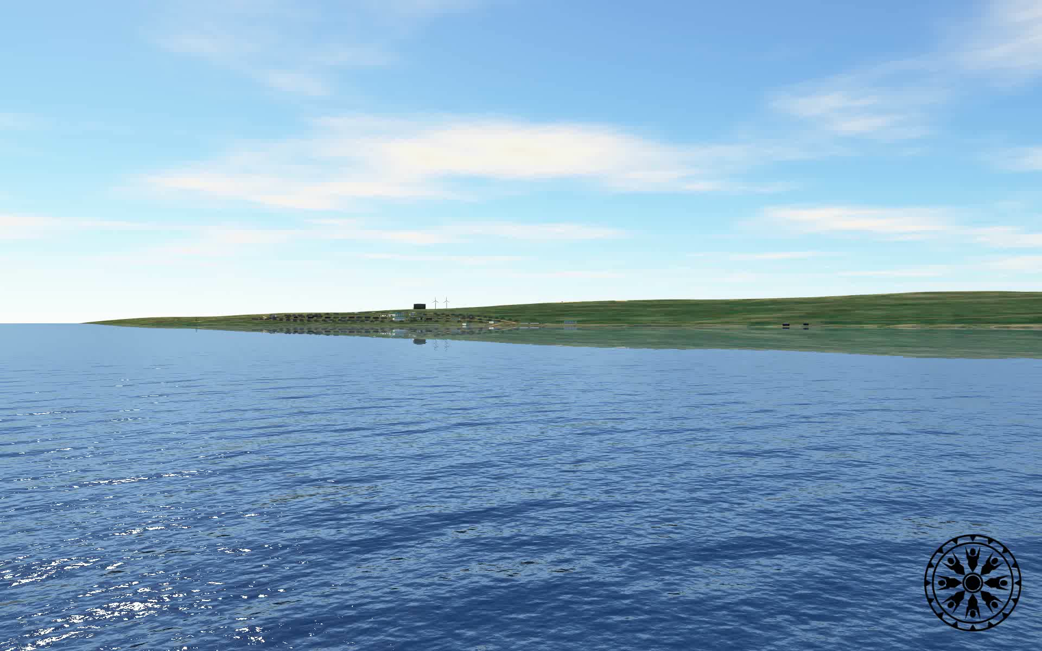
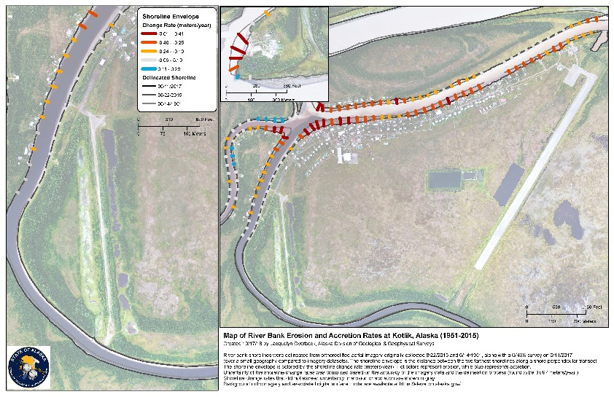
Agile Innovations
“Managed Retreat” – Moving Threatened Infrastructure
  Physical Infrastructure Relocation
    Newtok – Mertarvik – Total Relocation
    Kotlik – Partial Relocation
    More to Come!

Slide 17
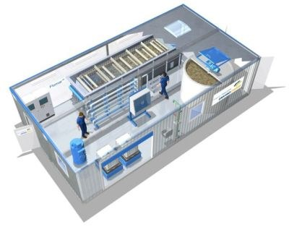
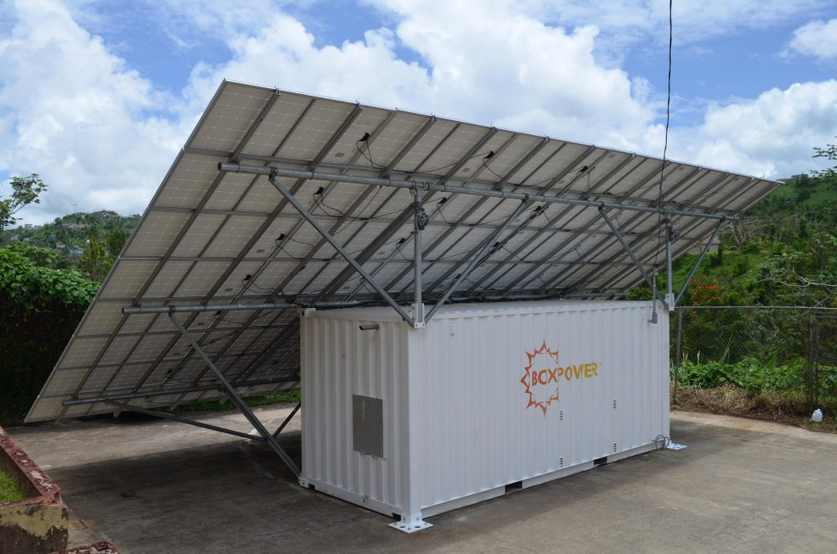
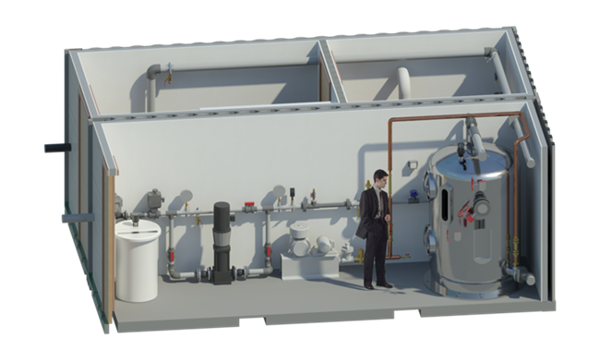
Agile Innovations
“Managed Retreat” – New Infrastructure
  Modularized Infrastructure – Mobile!
    Water Treatment Plants
    Washeterias
    Wastewater Treatment Plants
    Power Systems
    Water and Sewer Systems (PASS)
      Portable Alternative Sanitation System

Slide 18
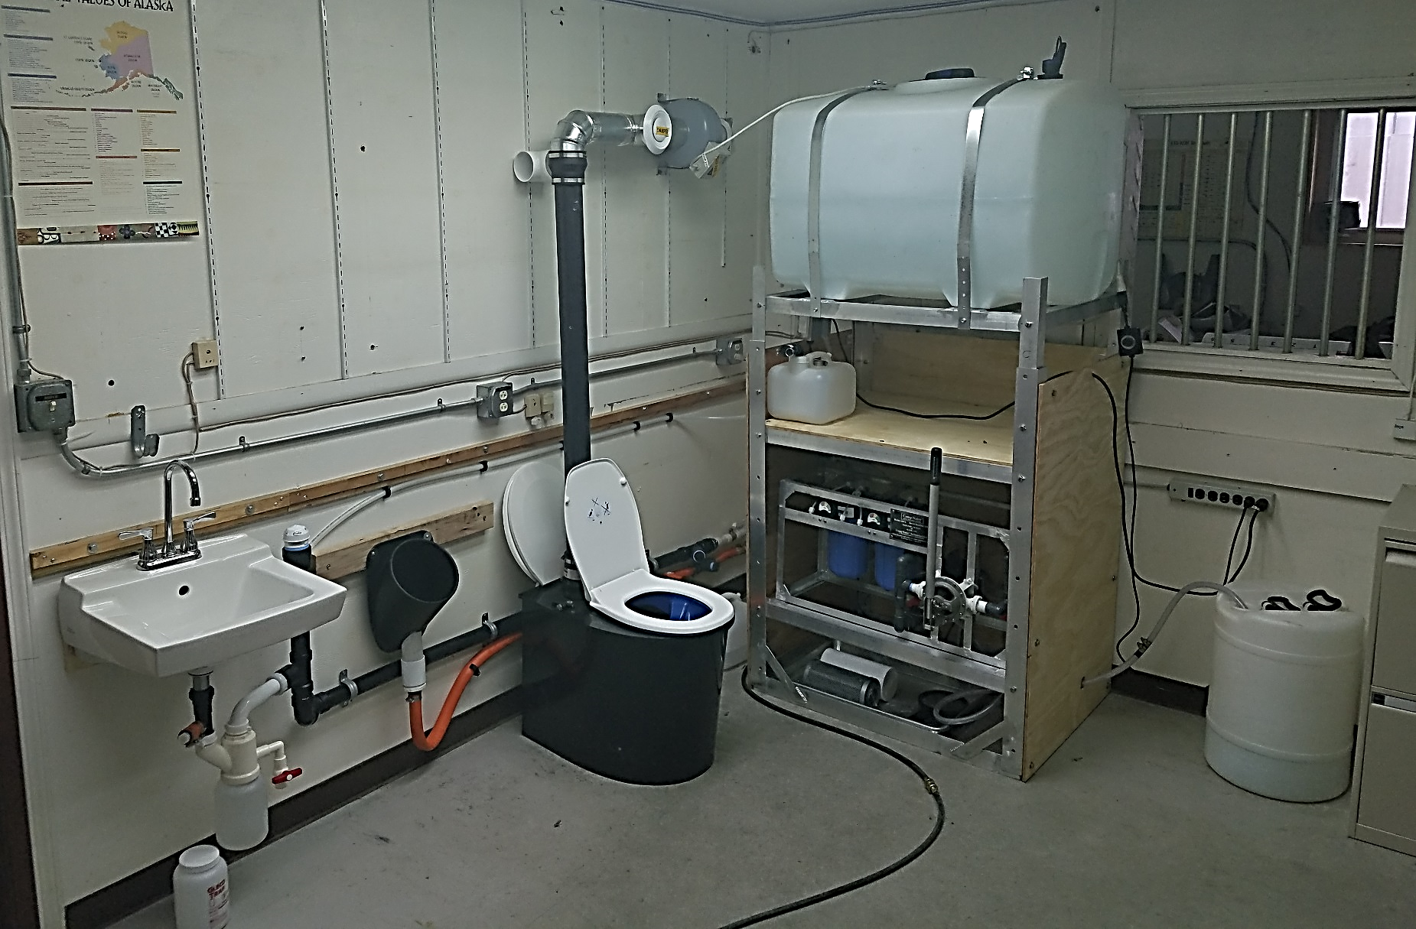
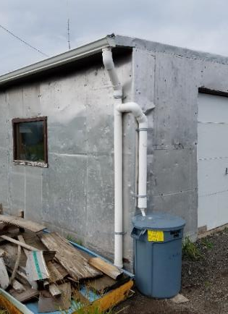
Agile Innovations
Portable Alternative Sanitation System - PASS
5
1
2
4
7
1. RAIN CATCHMENT
2. WATER STORAGE TANK
3. LOW-FLOW SINK
4. WATERLESS URINAL
5. INTEGRATED VENTILATION
6. SEPARATING TOILET
7. WATER TREATMENT SYSTEM
3
6

Slide 19

Conclusion
Many Changing Environments
  Political-Financial
  Natural
Agility and Adaptability are Key to Survival!
New Innovation Abounds

Slide 20




Thank You for Your Time!
CDR Michael G. Roberts, USPHS, PE, REHS
Deputy Director of Project Management
ANTHC/DEHE
4500 Diplomacy Drive
Anchorage, AK 99508
(907) 729-4092
mgroberts@anthc.org

